Slide 1
Cryptography

Slide 2
Cryptography
Cryptography is the study of secure communications techniques that allow only the sender and intended recipient of a message to view its contents.
ABC (meaningful message) → ZYX(cipher)
Notes:
Process ta ke cryptography bole

Slide 3
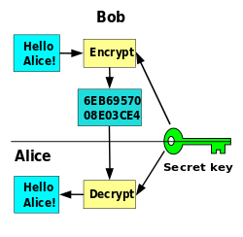
Cryptography
Notes:
Bob alice ke msg pathacche
Msg ke ascii code e convert korar por encrypt korche dhoro
Majher blue color er oi text ta hocche cipher text

Slide 4
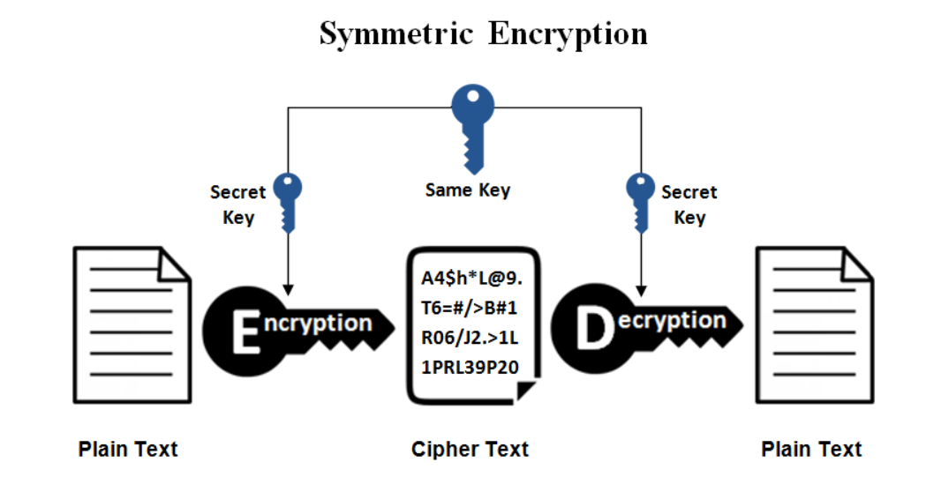
Symmetric vs Asymmetric Cryptography
Notes:
Calculation kom
Faster
Problem holo secret key 2 ta same. So age kar dine physically dekha kore key share korte hoto. Ekhon eita possible na.
So ei symmetric key ta amra asymmetric way te transfer kore dewar try korbo.
Then normal text gula normally

Slide 5
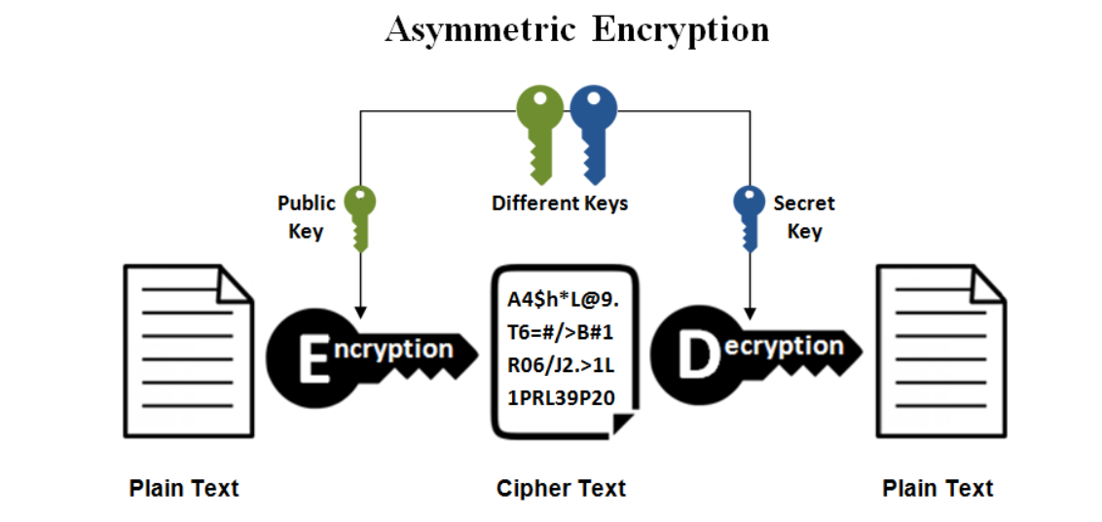
Symmetric vs Asymmetric Cryptography
Notes:
Receiver ashole sobai ke bole dey je take kono msg pathale ei key use kore msg pathate.
So sender oi key (public key) peye gele then encrypt kore pathay dey.

Slide 6
What is AES?
AES is an encryption standard chosen by the National Institute of Standards and Technology(NIST), USA to protect classified information. It has been accepted world wide as a desirable algorithm to encrypt sensitive data.
It is a block cipher which operates on block size of 128 bits for both encrypting as well as decrypting.
Each Round performs similar operations.
Notes:
AES hocche symmetric cryptography er jonno
Advanced Encryption Standard (AES) is a symmetric block cipher chosen by the U.S. government to protect classified information.

Slide 7
Why AES?
In 1990's the cracking of DES algorithm became possible.
Around 50 hours of brute-forcing allowed to crack the message.
NIST started searching for new feasible algorithm and proposed its requirement in 1997.
In 2001 Rijndael algorithm designed by Rijment and Daemon of Belgium was declared as the winner of the competition.
It met all Security, Cost and Implementation criteria.

Slide 8
How Does AES work?
AES basically repeats 4 major functions to encrypt data. It takes 128 bit block of data and a key and gives a ciphertext as output.The functions are:
Substitute Bytes
Shift Rows
Mix Columns
Add Key
Notes:
AES e same shared key lagbe

Slide 9
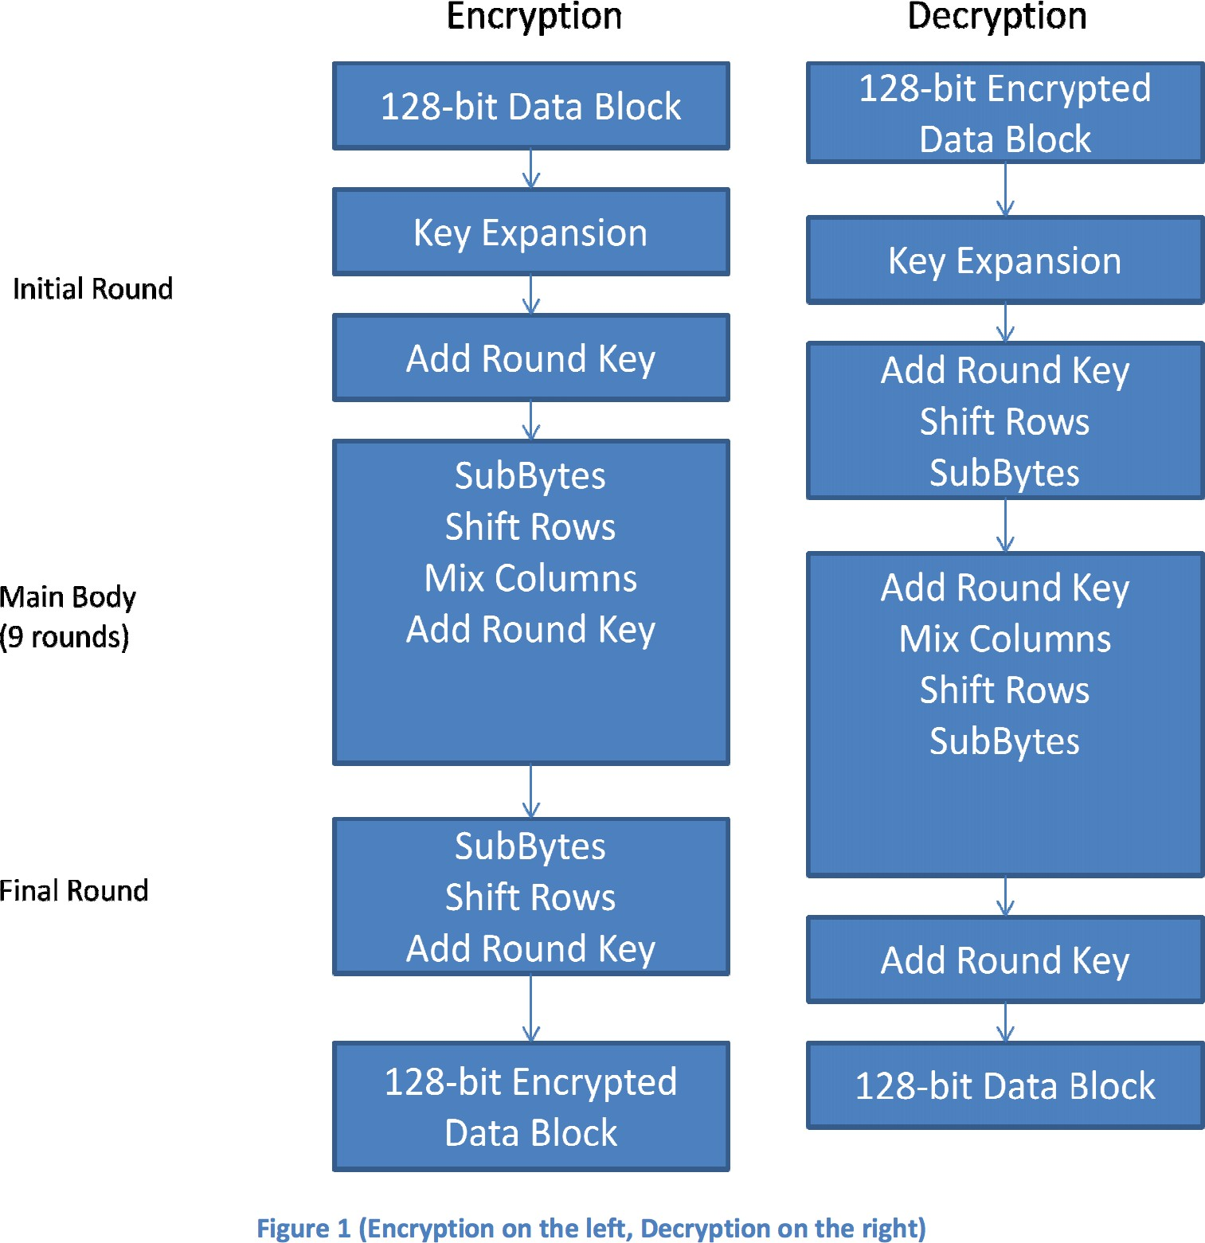
Steps for encryption and decryption

Slide 10
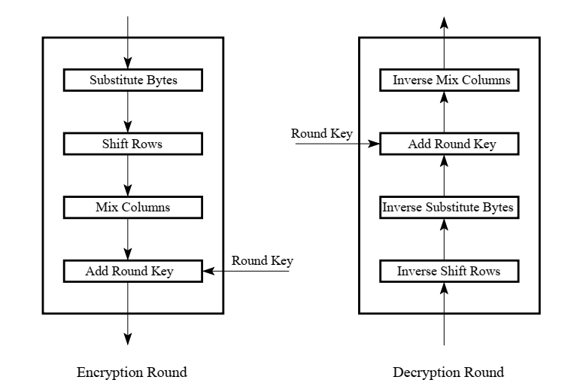
Steps for encryption and decryption

Slide 11
Analysis of Steps: Key Expansion
Key Expansion: In the key expansion process the given 128 bits cipher key is stored in a [4]x[4] byte matrix (16*8=128 bits) and then the four column words of the key matrix is expanded into a schedule of 44 words (44*4=176 bytes) resulting in 11 round keys.
Number of round keys = N_{r} + 1. Where N_{r} is the number of rounds (which is 10 in case of 128 bits key size). So, here, number round keys = 11.

Slide 12
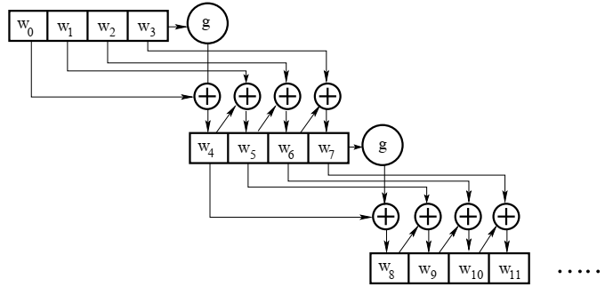
Analysis of Steps: Key Expansion

Slide 13
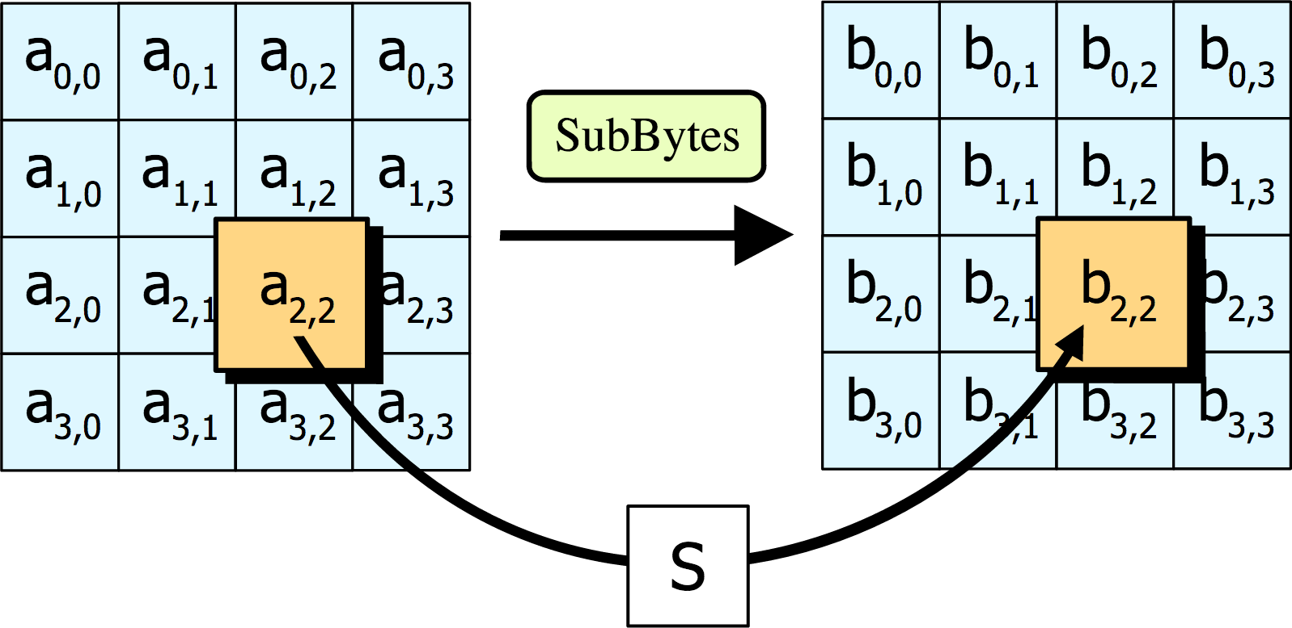
Analysis of Steps: Substitute Bytes
SubBytes: Each element of the matrix is replaced by an element of the S-box matrix.

Slide 14
Analysis of Steps: Substitute Bytes
SubBytes: Each element of the matrix is replaced by an element of the S-box matrix.
The S-box is a special lookup table which is constructed from Galois fields.
The Generating function used in this algorithm is GF(2⁸).
i.e., 256 values are possible
The elements of the S-box are written in hexadecimal system.

Slide 15
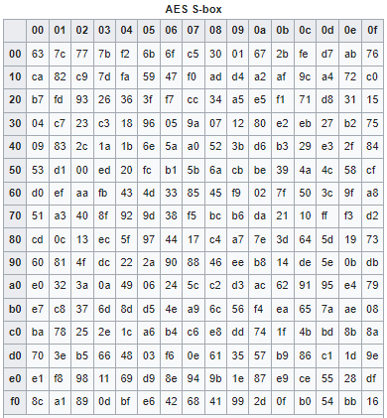
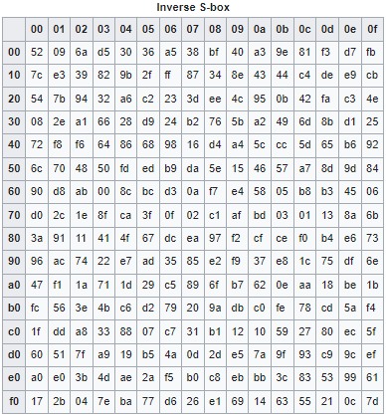
Analysis of Steps: Substitute Bytes

Slide 16
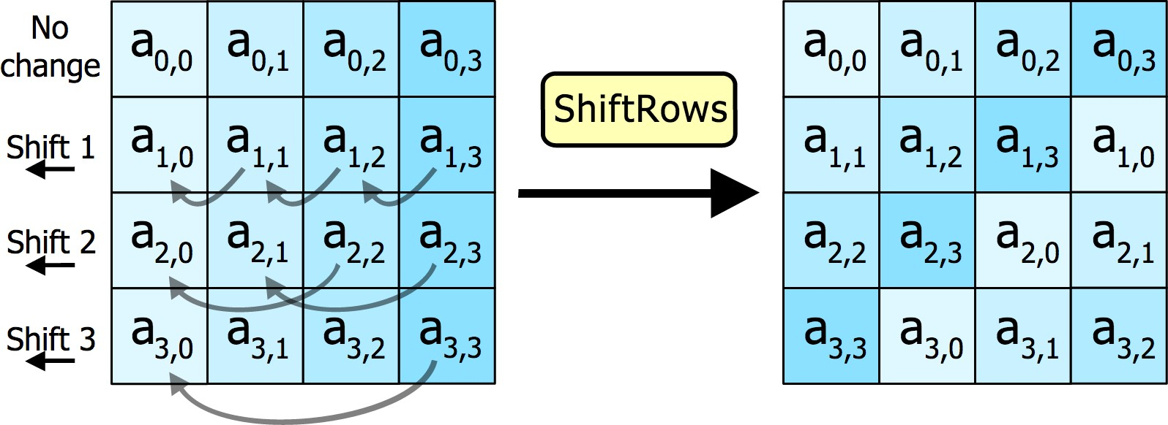
Analysis of Steps: Shift Rows
Shift Rows: In this step rows of the block are cylindrically shifted in left/right direction. The first row is untouched, the second one is shift by one, third one by two and the fourth one by three.

Slide 17
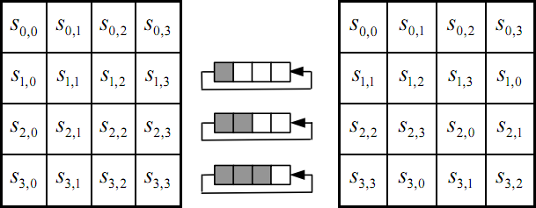
Analysis of Steps: Shift Rows

Slide 18
Analysis of Steps: Mix columns
Mix columns: This is the most important part of the algorithm. It causes the flip of bits to spread all over the block. In this step the block is multiplied with a fixed matrix. The multiplication is a field multiplication in galois field.
For each row there are 16 multiplication, 12 XORs and a 4 byte output.

Slide 19
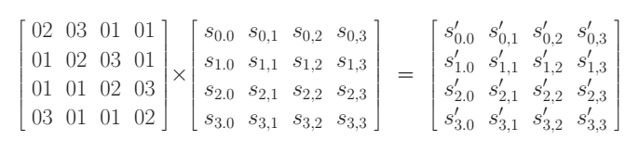
Analysis of Steps: Mix columns

Slide 20
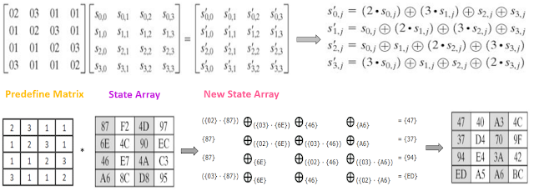
Analysis of Steps: Mix columns

Slide 21
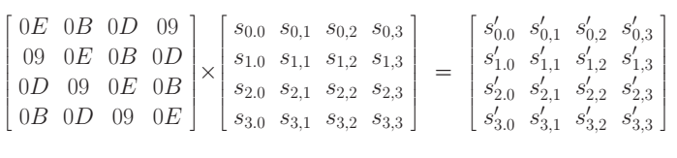
Analysis of Steps: Mix columns

Slide 22
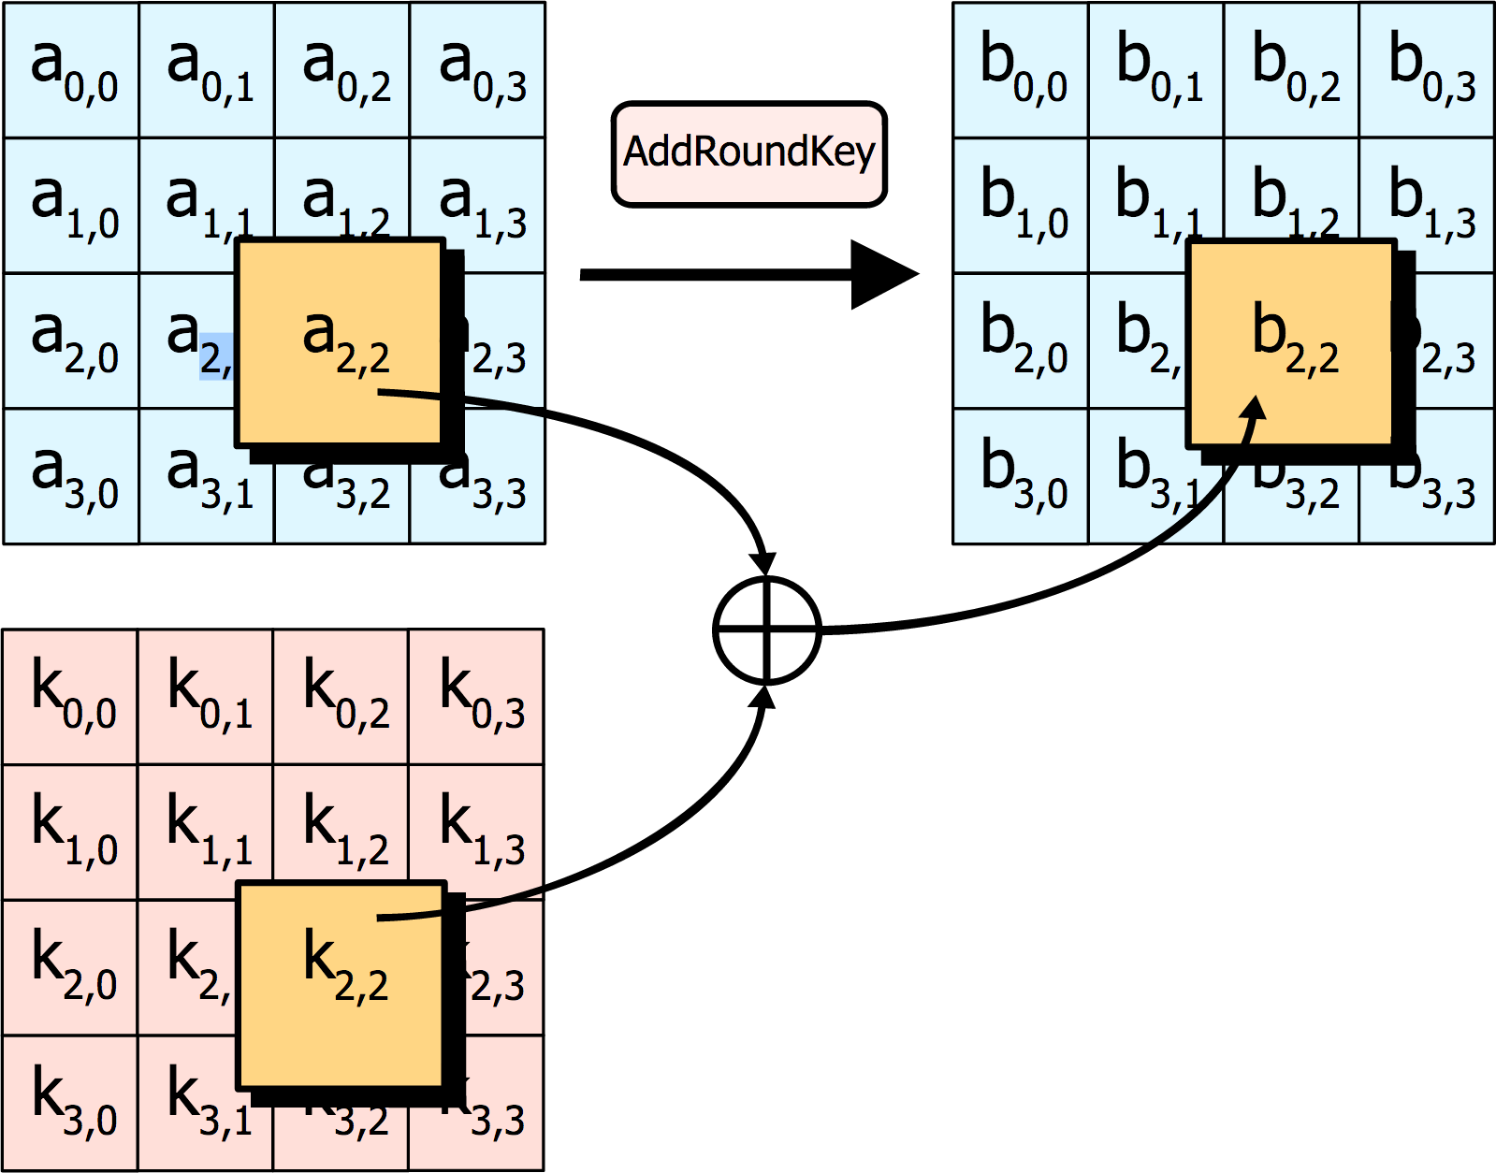
Analysis of Steps: Add round key
Add round key: In this step, each byte is XOR-ed with corresponding element of the key matrix.

Slide 23
Diffie Hellman
Notes:
Amra Diffie Hellman key exchange use korbo

Slide 24
Diffie Hellman method
mathematical method of securely exchanging cryptographic keys over a public channel
one of the earliest practical examples of public key exchange implemented within the field of cryptography
earliest publicly known work that proposed the idea of a private key and a corresponding public key
The security of this protocol relies on the practical difficulty of finding discrete logarithm

Slide 25
Diffie Hellman steps
Alice and Bob agree on a natural number n and a generating element g in the finite cyclic group G of order n. (This is usually done long before the rest of the protocol; g is assumed to be known by all attackers.) The group G is written multiplicatively.
Alice picks a random natural number a with 1 < a < n, and sends the element gª of G to Bob.
Bob picks a random natural number b with 1 < b < n, and sends the element g^{b} of G to Alice.
Alice computes the element (g^{b})ª = g^{ba} of G.
Bob computes the element (gª)^{b} = g^{ab} of G.

Slide 26
RSA

Slide 27
RSA
RSA is one of the oldest asymmetric encryption algorithm.
The acronym "RSA" comes from the surnames of Ron Rivest, Adi Shamir and Leonard Adleman.
The security of RSA relies on the practical difficulty of factoring the product of two large prime numbers, the "factoring problem".

Slide 28
RSA algorithm steps: Key-Generation
Step-1: Select two large prime numbers p and q where p ≠ q
Step-2: Calculate n = p⋅q
Step-3: Calculate λ = LCM((p–1),(q–1))
Step-4: Select e such that,
e is relatively prime to λ, i.e. gcd(e, λ) = 1
1 < e < λ
Step-5: Calculate d = (e^{–1}) (mod λ), so e⋅d = 1 (mod λ)
Step-6: Public key = {e, n}, private key = {d, n}

Slide 29
RSA algorithm steps: Encryption
Let P be the plain text
Find out the ciphertext C using the formula, C = P^{e} (mod n) where, P < n

Slide 30
RSA algorithm steps: Decryption
Let C be the ciphertext
Find out the plain text P using the formula, P = C^{d} (mod n) where, C < n

Slide 31
Thank you

